Slide 1
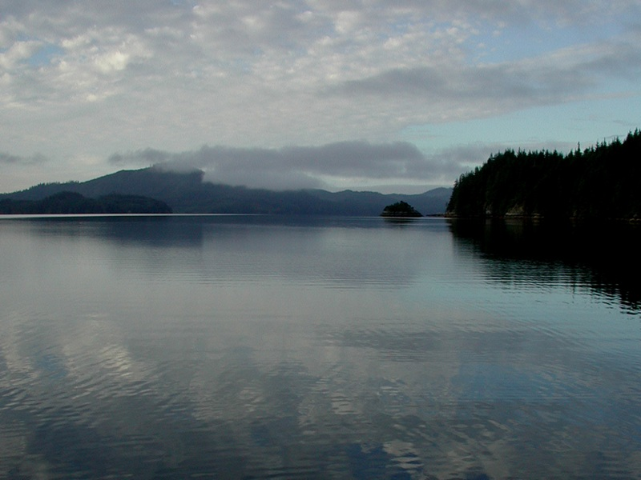


Slide 2
Washington Boaters and Marine Sewage Pumpouts
Survey Results from the 2010-2011 Pumpout Washington Campaign
Northwest Marina & Boatyard Conference, Nov 10, 2011
Aaron Barnett, Washington Sea Grant
aaronb5@u.washington.edu

Slide 3
Outline
Share what we found out from boaters that relates to marina and boatyard operators.
Present what marina operators had to say about pumpout equipment and the Clean Vessel Act Program.
Discussion

Slide 4
Pumpout Washington Campaign
Educate Washington boaters about the harmful effects of raw sewage and raise their awareness of the benefits of using pumpouts.
Accomplishments
Thousands of boaters reached through a science based, multi-
pronged and highly interactive campaign in partnership with Puget
Soundkeeper Alliance
Developed statistical baseline regarding boaters’ attitudes &
behaviors.

Slide 5
The Clean Vessel Act Matching Grant Program
Created in response to concerns about the environmental impacts of raw sewage from recreational boaters.
A “grossly inadequate” number of pumouts available (U.S. Senate, 1992) -- 52 pumpout stations for 436 marinas in Chesapeake Bay.
Over 5,500 pumpout stations funded in 28 states by CVA since 1992.
Over 4 million gallons of sewage pumped out in WA in 2010.

Slide 6
“successful but hard to measure”
Research Question
In Washington State, have awareness and access conditions-of use – imposed on grant participants (marina operators) – influenced boater behavior towards the Program’s objective of pollution inputs reduction?

Slide 7
Methodology
Control Variable-CVA $$
Pumpout Units
Boater Education
Independent Variable-Conditions of Use
Access
Awareness
Dependent Variable-Attitudes & Behavior
Reduced Pollution
Improved Water Quality
Operations
CVA $$ Comes from Sport Fish Restoration Trust Fund

Slide 8
Population

Slide 9
Access, Awareness & Operations
Do boaters find pumpouts accessible or convenient?
Are boaters aware of the CVA Symbol and illegality of discharge?
Do boaters think pumpouts are easy to use and usually find them working?

Slide 10
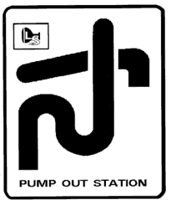
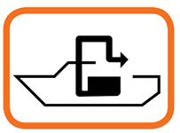
Awareness of the CVA Symbol
78% (488 of 627) of the boaters surveyed said they know that this symbol refers to sewage pumpouts.

Slide 11
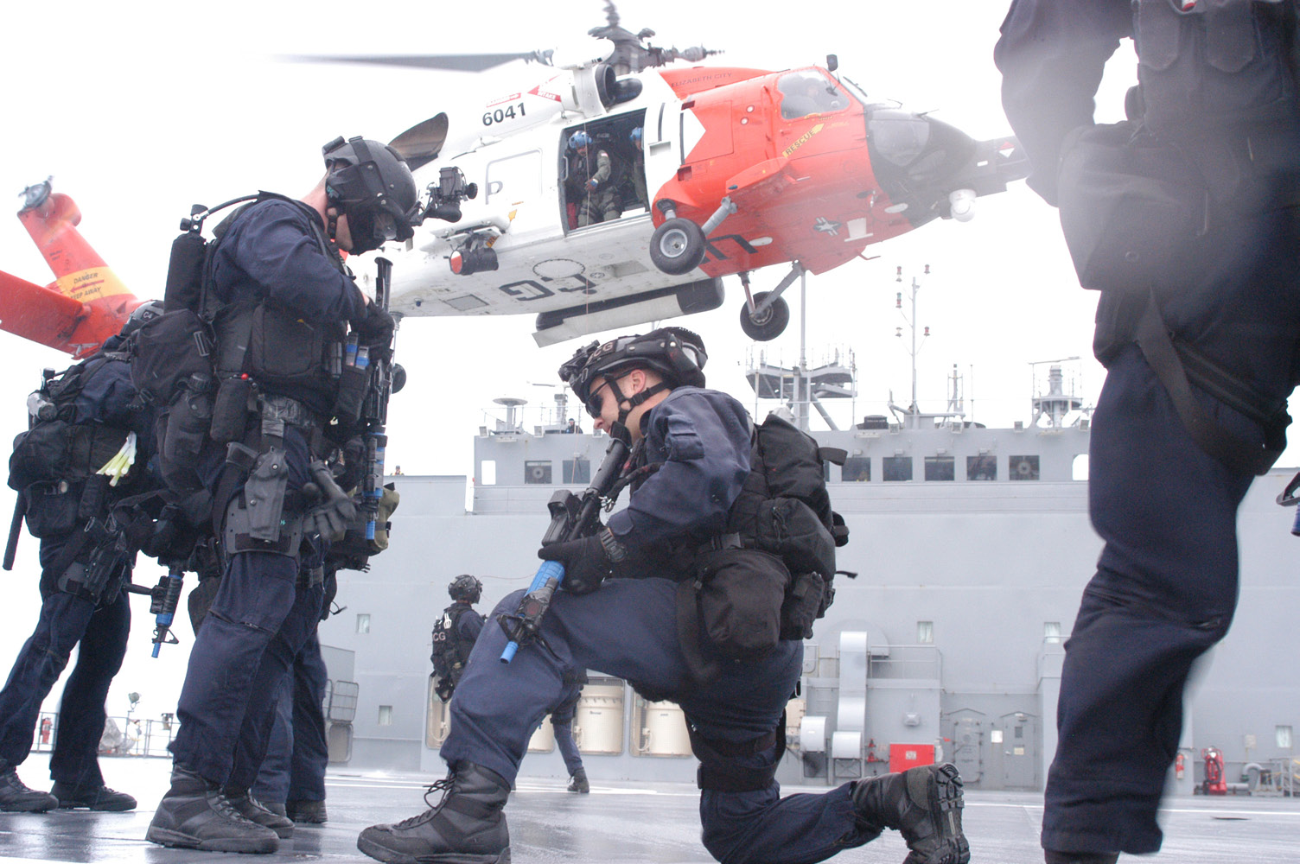
Awareness of the Illegality of Overboard Discharge
88.5% (562 of 633) of boaters surveyed are aware that it is illegal to discharge within three miles of coastlines.

Slide 12
Awareness of Environmental Impact
82% (579 of 630) agreed when asked if untreated sewage can harm the environment.
71% (439 of 619) of respondents disagreed when asked if sewage from boats is biodegradable and generally harmless.*
*an awareness of sewage as nutrient matter subject to breakdown (biodegradable; requiring the
consumption of oxygen).

Slide 13
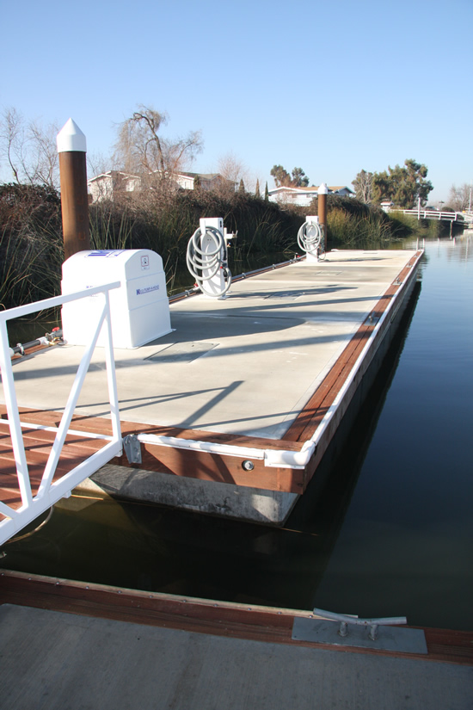
Access
Are pumpouts usually open?
61% Agreed they are usually open when
they want to use them.
Are pumpouts are conveniently located?
64% Agreed they are conveniently located.*
*Marina Specific?
Bethel, CA

Slide 14
Operations
72% agreed that they are easy-to-use.
71% agreed that they usually work.
69% agreed that pumpouts work better today than in the past.
77% said no when asked if they use pumpouts because they usually found them out-of-order.

Slide 15
Marina Operators
64% Public (23)
36% Private (13)
90% have a pumpout station.
73% (24 of 33) are CVA funded, 27% said no, 3 unanswered (don’t know?).

Slide 16
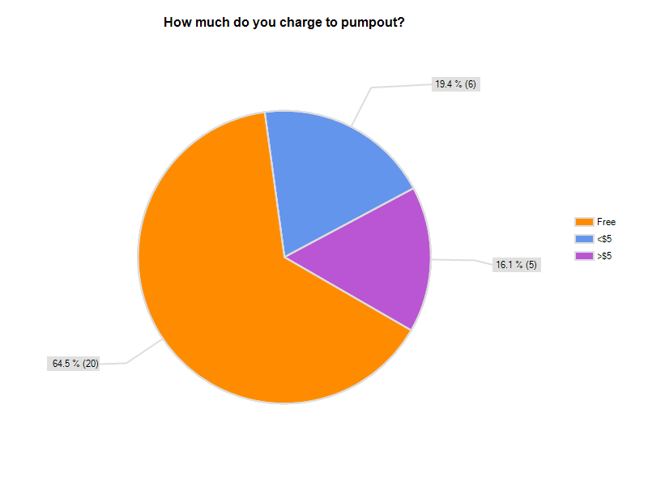
65% Free
16% < $5
19% > $5

Slide 17
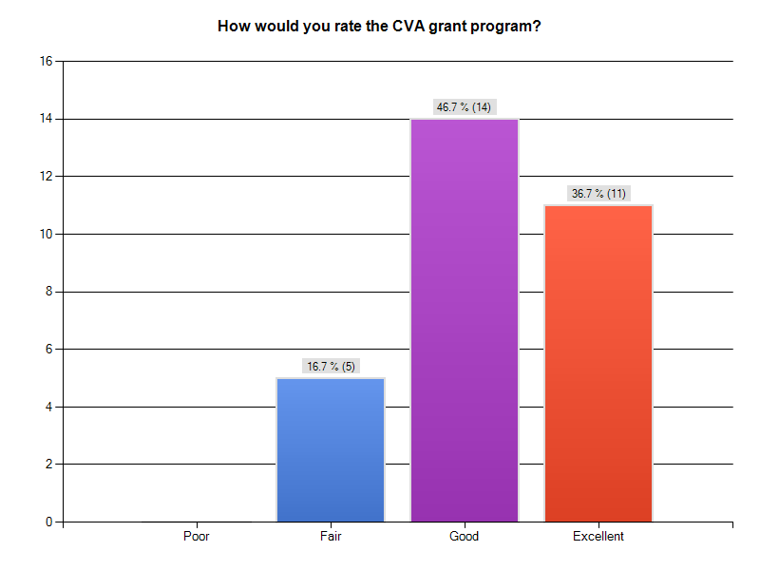

Slide 18
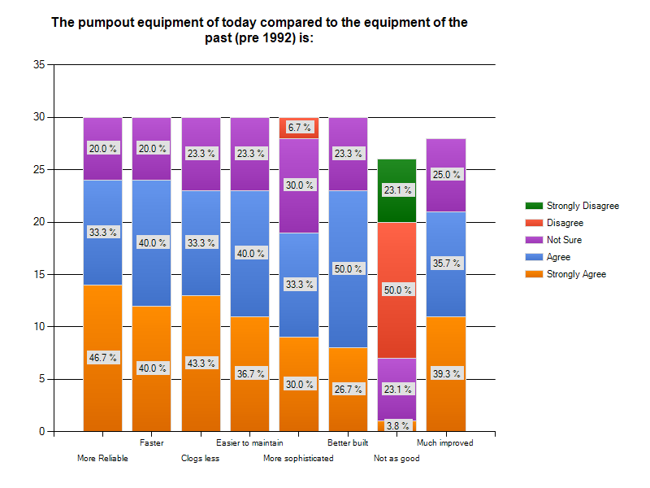

Slide 20
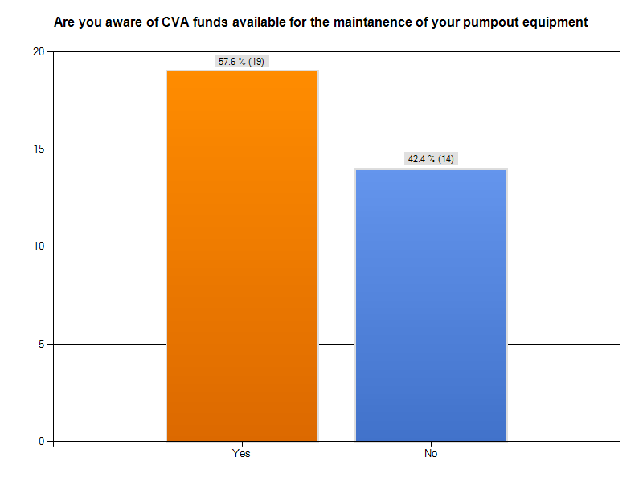

Slide 21
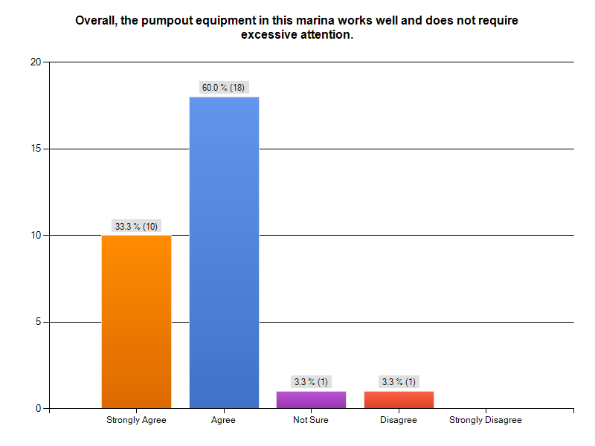
93% Agree

Slide 22
Conclusions
Wa boaters have a high level of awareness of the availability of pumpouts and the environmental impacts of dumping raw sewage.
Overwhelmingly feel it’s the right thing to do.
Less positive response regarding access -- room for improvement.
Behavioral change as a direct result of campaigns is hard to measure.
Pumpout equipment has improved.

Slide 23
How Does This Relate to Marina Operators?
“If you build it they will come”
~ unknown
A pumpout will get used if the boating public knows where it is, if it works, is accessible and affordable.
CVA matching grants available through Washington State Parks Boating Program for new equipment, operations and maintenance.
(360) 902-8842 or boatpumpouts@parks.wa.gov

Slide 24
References
American Medical Association (2004). Foodborne Diseases and Conditions Designated
as Notifiable at the National Level – United States 2003
Baasal-Tillis, P. Tucker-Carver J. Garbage and Sewage Disposal From Recreational
Boats. Journal of Environmental Health. (1998) Nov; 61(4): 8
Buck (2011). The Sport Fish Restoration and Boating Trust Fund. University of
Nebraska, Lincoln. Retrieved from the world wide web 4/22/2011.
http://digitalcommons.unl.edu/crsdocs/73/
Mackas, D.L. & Harrison, P.J. Nitrogenous Nutrient Sources and Sinks in the Juan de
Fuca Strait/Strait of Georgia/Puget Sound Estuarine System: Assessing the Potential for Eutrophication. Estuarine, Coastal and Shelf Science (1997) 44, 1-21.
The U.S. Boat Building and Repairing Industry: National Trends and Characteristics.
Center for Competitive Analysis (2000).
EPA, (2009). Vessel Sewage Discharges and No Discharge Zones,
EPA (2001). National Management Measures to Control Nonpoint Source Pollution from Marinas and Recreational Boating. EPA 841-B-01-005, November 2001
EPA (2007). National Estuary Program Coastal Condition Report Chapter 3: Northeast
National Estuary Program Coastal Condition, Buzzards Bay National Estuary
Program. June 2007.
FDA #102, (1987). Evaluation of Marinas by State Sanitation Control Officials. FDA
Guidelines. Shellfish Sanitation Branch. Washington, D.C.
Gupta. D. K. Analyzing Public Policy. CQ Press: Washington D.C. (2001)
Mcgraw Hill: Camden, Maine. (2004).
Tomczak, M Jr. Defining Marine Pollution: A Comparison of Definitions Used by
International Conventions. Marine Policy, October 1984.
United States Coast Guard. Recreational Boating Statistics. (2009) p.63
Guidelines for Sewage Collection and Disposal for Recreational Boats,
Commercial Vessels and Floating Structures. State of Oregon, Dept of
Environmental Quality and State Marine Board. (1996).
SOBA. (2004). Performance Testing of Marine-Use Waste Pump-out Stations. States
Organization of Boating Access. Chicago, IL.
Hearing Before the Committee On Commerce, Science, And Transportation, United
States Senate One hundred Second Congress Second Session. United States Senate. (1992)
Clean Vessel Act Program.(2099) United State Code Part 85. Title 50: Wildlife and
Fisheries.
WA Parks. (2011). Adventures in Boating: A Course on Responsible Boating.
Washington State Parks and Recreation Commission. Olympia, WA P.36
Weimer, D. L. & Vining, A. R. Policy Analysis: Concepts and Practice. Fourth
Edition. Pearson, Prentice Hill: Upper Saddle Hill, New Jersey. (2005)
Young, O. et al. Solving the Crisis in Ocean Governance: Place-Based Management of Marine Ecosystems. Environment: Science and Policy for Sustainable Development. Environment. Volume 49 Number

Slide 25
References Cont’
Hamrick, J. & Neilson, B. Determination of Marina Buffer Zones Using Simple Mixing
and Transport Models. Virginia Institure of Marine Science. Gloucester Point VA.
June 1989.
National Association of State Boating Law Adminstrators. Sport Fish Restoration &
Boating Trust Fund Reauthorization. Retrieved from the World Wide Web April
30, 2011. http://nasbla.org/i4a/pages/index.cfm?pageid=3379. (2011)
National Marine Manufactures Association. (2004). 2002 U.S.Recreational Boat
Registration Statistics).
Duda, M. D. et al. (2007). Washington Boater Needs Assessment: Executive
Summary. Responsive Management, Inc. Harrisonburg, VA.
Sport Fishing and Boating Partnership Council (1992-2007). Boater’s Investment In
Clean Water: A Review Of The Clean Vessel Act

